Slide 1
Graphics
Group G
Binay Shah
Papila Ghising
Prajwal Sigdel
Umesh Krishna Shrestha

Slide 2
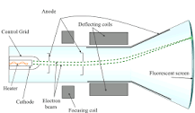
A cathode-ray tube (CRT) is a vacuum tube containing one or more electron guns, the beams of which are manipulated to display images on a phosphorescent screen. The images may represent electrical waveforms (oscilloscope), pictures (television set, computer monitor), radar targets, or other phenomena.
The first cathode ray tube scanning device was invented by the German scientist Karl Ferdinand Braun in 1897. Braun introduced a CRT with a fluorescent screen, known as the cathode ray oscilloscope. The screen would emit a visible light when struck by a beam of electrons.

Slide 3
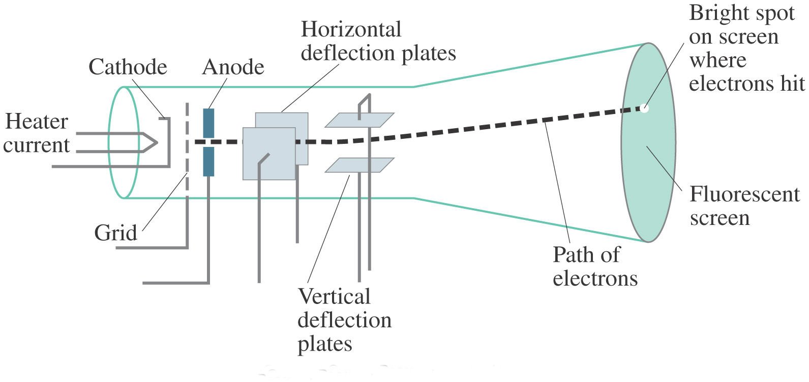

Slide 4
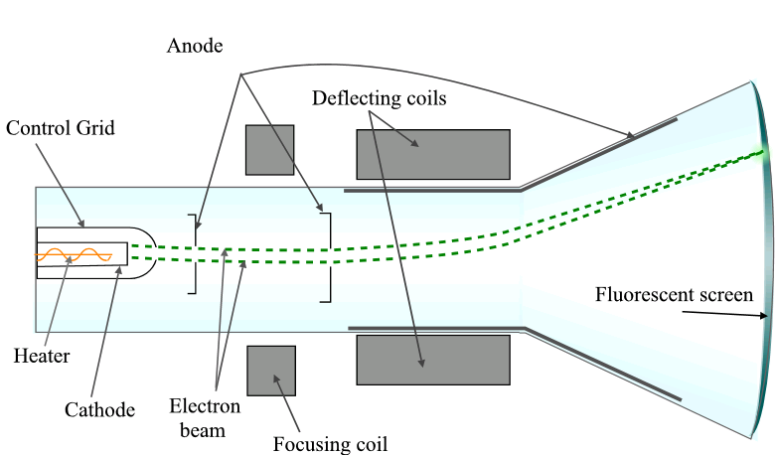

Slide 5
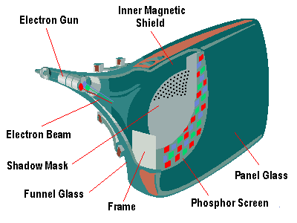

Slide 6
• Electron gun is the primary component of a CRT. When the heat is supplied to the electron gun by directing a current, a beam of electrons emitted by an electron gun, passes through focusing and deflection systems that direct the beam toward specified positions on the phosphor-coated screen.
• The focusing system in a CRT is needed to force the electron beam to converge into a small spot as it strikes the phosphor.
• There are two pairs of deflection plates - Horizontal deflection plates and vertical deflection plates or by magetic fields.

Slide 7
• The phosphor then emits a small spot of light at each position contacted by the electron beam. Phosphor is chemical coating (Zn, S, P, Se, As, Te, and rare earth)
• Because the light emitted by the phosphor fades very rapidly, some method is needed for maintaining the screen picture.
• One Way to keep the phosphor glowing is to redraw the picture repeatedly by quickly directing the electron beam back over the same points. This type of display is called a refresh CRT.

Slide 8
• In CRT monitors there are two techniques of displaying images:
Random(vector) scan display
Raster scan display

Slide 9
Electron beam is directed only to the points of the screen where a picture is to be drawn eg. Oscilloscope and Radar screen.
- Refresh rate depends on the number of lines to be displayed.
- Picture definition is stored as a set of line drawing commands in system memory called display file (or display program or display list).
–
- Random scan displays are designed to draw all the components of a picture 30 to 60 times each second.

Slide 10
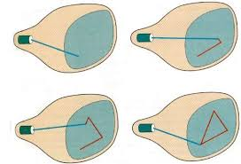

Slide 11
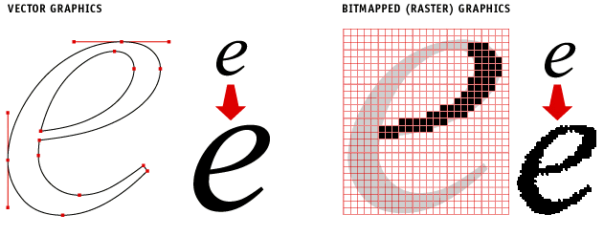

Slide 12
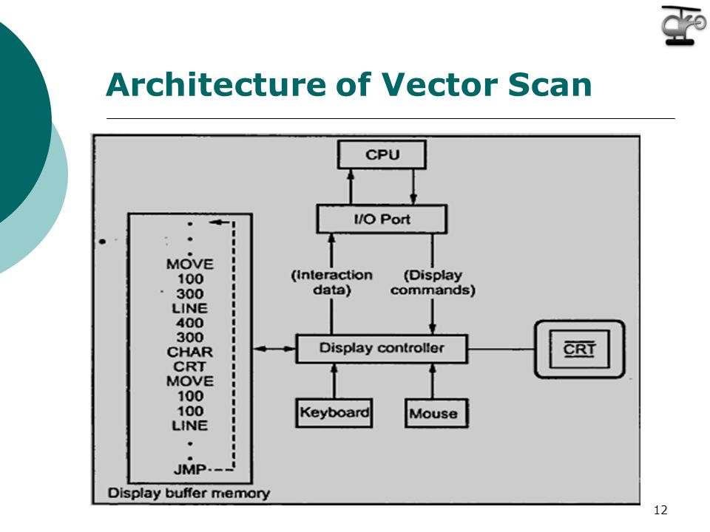

Slide 13
Advantage
High resolution & better time interval.
Better than raster for animation, requires only end point information.
produces smooth line.
-- Random scan displays are designed to draw all the components of a picture 30 to 60 times each second

Slide 14
Disadvantage
can’t fill area with patterns and manipulate bits.
Random scan monitors cannot display realistic shades scenes.

Slide 15
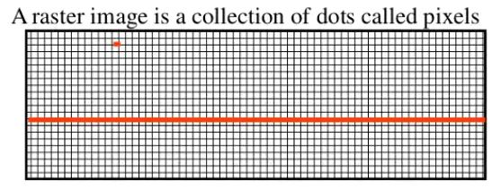
What is raster scan?
A raster scan, or raster scanning, is the rectangular pattern of image capture and reconstruction.
Raster Scan Displays are most common type of graphics monitor which employs CRT.
It is a systematic process of covering the area progressively, one line at a time.
Raster images are created with pixel-based programs or captured with a camera or scanner.
They are more common in general such as jpg, gif, png and are widely used on the web.

Slide 16
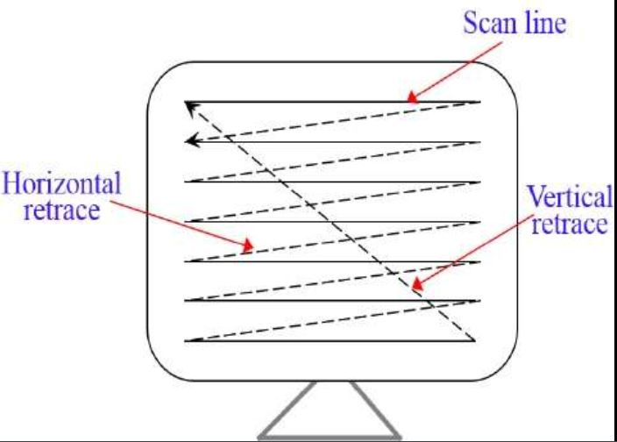
How raster scan works:
In a raster scan system, the electron beam is swept across the screen, one row at a time from top to bottom.
As the electron beam moves across each row, the beam intensity is turned on and off to create a pattern of illuminated spots.
The return to the left of the screen, after refreshing each scan line is called Horizontal retrace. At the end of each frame the electron beam returns to the top left corner of the screen to begin the next frame is called Vertical retrace:

Slide 17
Picture definition is stored in a memory area called the refresh buffer or frame buffer. Refresh buffer or frame buffer is memory area that holds the set of intensity values for all the screen points.
Stored intensity values then retrieved from refresh buffer and "painted° on the screen one row (scan line) at a time.
The quality of a raster image is determined by the total number pixels (resolution), and the amount of information in each pixel (color depth)
A black-and-white system: each screen point is either on or off, so only one bit per pixel is needed to control the intensity of screen positions. Such type of frame buffer is called Bit map
High quality raster graphics system have 24 bits per pixel in the frame buffer (a full color system or a true color system)
Refreshing on raster scan displays is carried out at the rate 60 to 80 frame per second.

Slide 18
Advantages and Disadvantages:
ADVANTAGES:
Real life images with different shades can be displayed.
Color range available is bigger than random scan display.
DISADVANTAGES:
Resolution is lower than random scan display.
More memory is required.
Data about the intensities of all pixel has to be stored.

